Slide 1
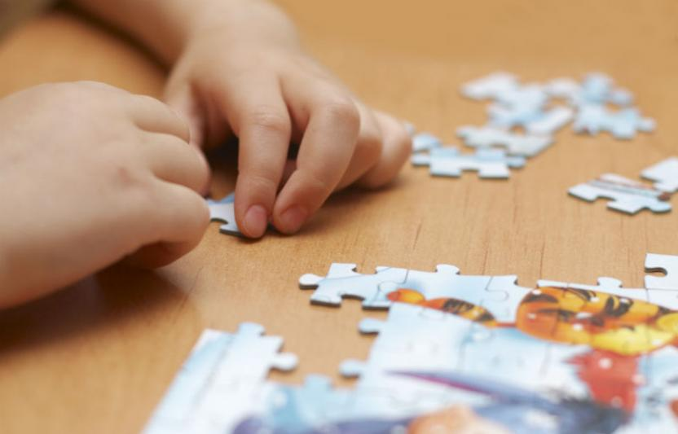



Grades 9-12 BCML Session 10
Building a Culture of Math Learning, Grades 9-12
Topic 4: Focusing on SMP 3
Session 10: Shared Learning

Slide 2
Content Cycle Overview
Building a Culture of Math Learning
The Standards for Mathematical Practice support a culture of math learning where students feel empowered to take academic risks, persevere in problem solving, make meaning of mathematics, explain their thinking, and reflect on their own learning.
12-week Content Cycle
Introduction to the Standards for Mathematical Practice (SMPs) | SMP 1: Make sense of problems and persevere in solving them. | SMP 4: Model with mathematics. | SMP 3: Construct viable arguments and critique the reasoning of others.
Week 1: Shared Learning Week 2: Planning & Practice Week 3: Student Progress | Week 1: Shared Learning Week 2: Planning & Practice Week 3: Student Progress | Week 1: Shared Learning Week 2: Planning & Practice Week 3: Student Progress | Week 1: Shared Learning Week 2: Planning & Practice Week 3: Student Progress
2

Slide 3


Norms
Our Norms
Add your school or team norms here
3

Slide 4
Objectives
Agenda
Internalize the language and look-fors of SMP 3 and draw connections between SMP 3 competencies and the ability to apply conceptual understanding to real world situations
Analyze specific teacher planning and instructional moves around incorporating SMP 3 within the lesson and the impact on student learning
Revisit SMP 3
Create an exemplar student response to a task by determining the target of the standard
Observe teacher moves in utilizing SMP 3 to increase student ability to apply conceptual understanding to real world situations
Reconnect to our “Why” - Equity
Reflect on Criteria for Success
Closing and next steps
4

Slide 5

Preview Criteria for Success
These are the look-fors we will be focusing on during Topic 4.
As we go through the session, identify connections between today’s learning and progress toward these look-fors.
Handout 1 - Page 5
5

Slide 6
Focusing on SMP 3
SMP 3: Construct viable arguments and critique the reasoning of others
Jot down your key takeaways on SMP 3 from our first shared learning session. What would utilizing SMP 3 look like for students?
Post-it Note
6

Slide 7
SMP 3 Share-Out
Mathematically proficient students understand and use stated assumptions, definitions and previously established results in constructing arguments.
They make conjectures and build a logical progression of statements to explore the truth of their conjectures.
They justify their conclusions, communicate them to others and respond to the arguments of others.
Students at all grades can listen or read the arguments of others, decide whether they make sense and ask useful questions to clarify or improve the arguments.
Post-it Note
7

Slide 8
Creating Exemplar Student Responses
Our Process: We’ll be using an annotated version of the Lesson Planning Tool.
Read the KAS for Mathematics and task aloud.
Create exemplar student responses and consider the questions that follow the task.
Handout 1
Handout 2
8

Slide 9
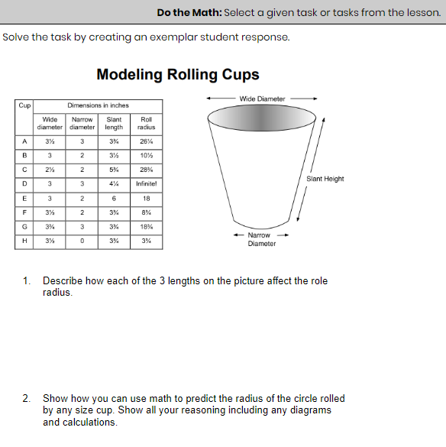
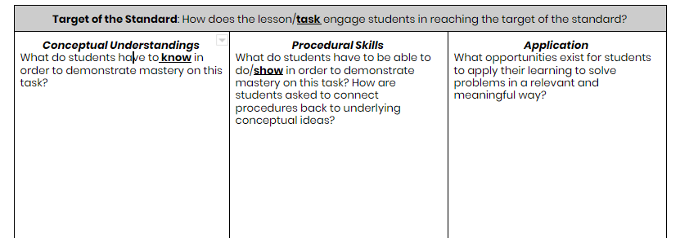
Task Share Out: Grades 9-12
Handout 1
9

Slide 10
SMP 3 in Action: Grades 9-12
Video Observation
Inside Mathematics Video
Molly McNinch, Geometry
Lesson 1B - Modeling through Geometry
(min 0:00-6:25)
Handout 1
10

Slide 11
Video Share Out: Grades 9-12
What planning steps did the teacher take to incorporate these SMP 3 into this instruction?
What instructional moves did the teacher take to incorporate SMP 3 into this lesson? What impact did this have on students?
11

Slide 12
Instruction Share Out: Grades 9-12
In what ways have you already incorporated SMP 3 into your instruction? What does this look like in terms of teacher and student actions?
After watching today’s video and continuing to reflect on your own practice, what might you try next?
With a partner
12

Slide 13
Revising our instructional resources
In the video, the teachers asks students to provide feedback and questions to others’ work during the gallery walk. Students must then defend and explain their thinking.
However, the task itself does not ask students to critique others’ work or to defend their own thinking.
Handout 1
13

Slide 14
Revising our instructional resources
Based on the guiding questions in the Assignment Review Protocol, we can see that the original task as written does not meet the focus practice standard, SMP 3.
How was the instruction revised to incorporate the practice standard?
Handout 1
14

Slide 15
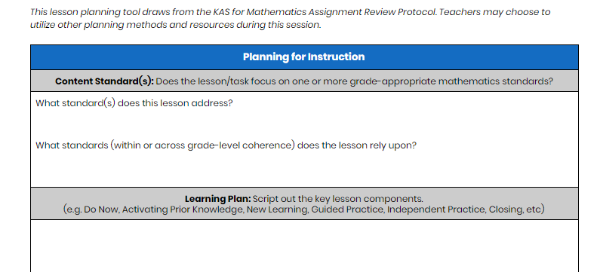
Revising our instructional resources
Think ahead to next week’s session -
Session 11: Planning & Practice.
Post-it
15

Slide 16
Guiding questions for planning
Based on the Mathematics Assignment Review Protocol, does my lesson/task meet the target of the standard? If not:
Are there conceptual understandings missing? How can I ask students to demonstrate their understanding using representational and abstract (algebraic) methods?
Are there opportunities for application missing? How can I add real world context or real world problems to get students to apply their understanding?
Will students engage in the Mathematical Practices by completing this task? How can offer explicit opportunities within the task and/or during instruction to ensure students meet the practice standards?
16

Slide 17
Reconnecting to our “Why”- Equity
How might explicitly teaching SMP 3 support both mathematical understanding and productive struggle for students, especially our most vulnerable students?
How might SMP 3 help students in accessing the target of the standard and/or task?
Handout 1
17

Slide 18
Criteria for Success
Criteria for Success
Read the teacher and student look-fors found on your handout.
How do these teacher and student look-fors connect to the focus for our learning this cycle?
Are there any look-fors you would add to the list?
Handout 1
18

Slide 19
Reflection and Looking Ahead
Complete the reflection on today’s session learnings, including a possible application of this learning to upcoming planning and instruction.
Handout 1
19

Slide 20
Closing Whip Around
Closing Whip Around
How might you explicitly teach students SMP 3 in an upcoming lesson?
How will you integrate SMP 3 so that it supports the mathematical content of the lesson, instead of isolated concepts or skills?

Slide 21
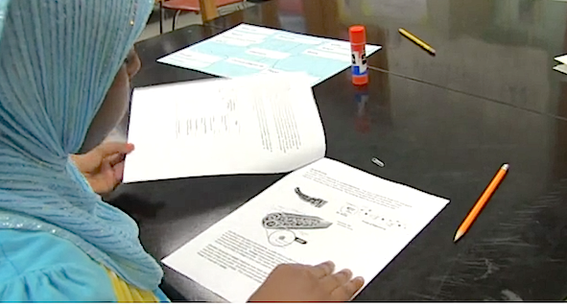
What’s Next
What's Next?
Session 11: Planning and Practice
Identify the implementation characteristics of SMP 3 and apply to planning and practice.
Give and receive feedback from colleagues in order to revise plans and refine practices
21
21

